Slide 1
Modeling and Factor Analysis for Food Wastes
Group 1

Slide 2
Contents
01
02
03
PROJECT OVERVIEW
DATASET INSPECTION
DATA PREPARATION
04
05
06
ANALYSIS
EVALUATION
TEAM ROLES & LESSONS LEARNED

Slide 3




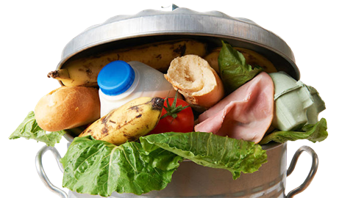
Project Overview
Motivation for Dataset Selection
Food waste has become a critical issue in achieving the Sustainable Development Goals (SDGs) in today’s world. This project aims to systematically analyze food waste through data, and from this analysis, propose efficient operational strategies and waste reduction plans.
Expected benefits by Data Analysis
Furthermore, it explores the potential to implement an incentive system based on the amount of food waste generated, enabling restaurants or operational units to receive rewards according to their waste reduction performance, thus providing a practical and scalable management approach.
Image Source: https://www.hobsonsbay.vic.gov.au/Services/Waste-and-recycling/How-to-use-your-four-bins/Food-Garden-Light-Green-Bin/How-Much-Food-Do-You-Think-You-Throw-Away-Every-Year

Slide 4
Project Overview
End to End process 7
Object setting
Data Inspection
Data Preparation
Data Analysis
Evaluation
In restaurants, hospitals, hotels, etc., food waste is directly related to costs.
Data exploration using the same plots as Boxplot, Histogram, and Scatter.
Suitability check -
In predicting
waste volume,
various factors are
logically related.
Data Value Changes cleaning dirty data,
text preprocessing,
discretization,
data normalization,
encoding
Feature engineering - selection, creation
Clustering - Kmeans : Deriving factor-based clusters
Regression -Interpretation by applying Linear Regression and LGBM Regression respectively
To solve the problem of food waste occurring in restaurants...etc.
Predict the amount of food waste using actual operation log data and contribute to establishing a reduction strategy through this.
K-Fold Cross Validation : Evaluate model performance more precisely for each cluster

Slide 5
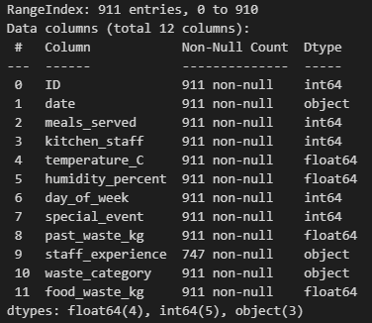
Dataset Inspection
- Contains some missing values and wrong data
- Total number of samples: 911
Main Columns Descriptions
Numerical Features
day_of_week : Numeric representation of the day
special_event : Whether a special event was held or not
meals_served: Number of meals served on the day
kitchen_staff: Number of kitchen staff working that day
temperature_C: Kitchen temperature (Celsius)
humidity_percent: Humidity of kitchen or cafeteria (%)
past_waste_kg: Average of wasted food generated in the past (Kg)
food_waste_kg: Amount of wasted food measured for a day (Kg)
Categorical Features
date: The date of food waste measurement
staff_experience: Experience levels among kitchen staff (Beginner, Intermediate, Expert)
waste_category: Type of waste (Dairy, Meat, Vegetables, Grains)

Slide 6
Data Preprocessing
Categorical data (‘staff_experience’, ‘waste_category)
: Converted to guilt and removed the replacement.
Outlier - ‘temperature_C’, ‘meals_served’
Missing Value - ‘temperature_C’, ‘paste_waste_kg’, ‘staff_experience’
Encoding - ‘staff_experience’, ‘waste_category’

Slide 7
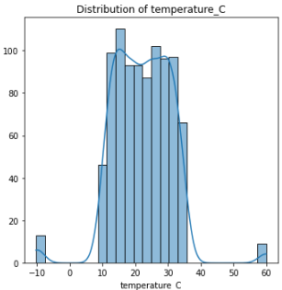
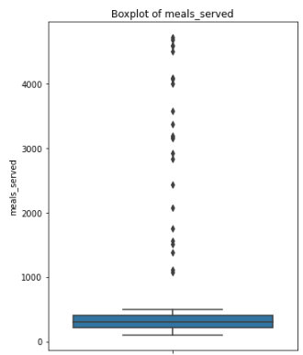
Data Preprocessing
Outliers
1. temperature_C
: Some temperature_C values are way too high (60°C) or too low (-10°C)
: In the "Temperature_C" column, calculate the most frequent value
from the values ​​greater than 0 and less than 36
(To obtain robust central tendency measurements for temperatures within a normal range)
→ Identify values ​​less than or equal to 0 or greater than or equal to 36 as outliers.
→ These outliers are replaced with the previously computed mode_temp.
2. meals_served
: Remove all rows more than 500,
which are extremely high (about 10 times higher than the normal range)
: Rows exceeding 500 are a minority.
The specific event data was 0
but the values ​​were extremely high and out of the normal range,
those rows were removed.

Slide 8
Data Preprocessing
Missing Value
1. temperature_C
: Any missing values ​​(NaN) remaining in the column are filled with mode_temp.
: The mode was selected because it is sensitive to outliers and is less affected by outliers.
2. paste_waste_kg
: Any missing values ​​(NaN) remaining in the column are filled with mean.
: The average was selected because it was normally distributed and reflected the overall trend well.
3. staff_experienced
: Considering the correlation between kitchen_staff and past_waste_kg.
: If there are few kitchen staff(<12) and a lot of waste(>20), it is processed as beginner,
if there are many kitchen staff(>17) and little waste(<15), it is processed as expert,
and the rests are processed as intermediate.

Slide 9
Data Preprocessing
Encoding
1. staff_experience
: begginer 0, intermediate 1, expert 2
: Since staff_experience represents an ordinal variable with a meaningful order of experience levels,
and the subsequent regression model interprets numeric values as having quantitative significance,
we manually encoded the categories as beginner 0, intermediate 1, and expert 2.
2. waste_category
: Label encoding was done in alphabetical order.

Slide 10
Feature Engineering
Feature creation
By standardizing and summarizing multiple features of each group (environment, operation, human),
we created a meaning-based representative value (score).
By performing clustering and regression modeling based on this score,
we improved the predictive power and interpretability.
Normalization within factors by MinMaxScaler and calculation(mean) of factor scores
→ Renormalize factor scores
env_features
ops_features
human_features
temperature_C
humidity_percent
meals_served
special_event
day_of_week
kitchen_staff
staff_experience

Slide 11
Data Analysis
Modeling Strategy : Clustering + Regression Approach
Goal
Food waste cause prediction
heterogeneous patterns depending on various environmental/operational/human conditions.
Approaches
Clustering
Customized analysis and prediction
: Each cluster has different characteristics,
customized solutions can be provided for each cluster.
Linear Regression
LGBM Regression

Slide 12
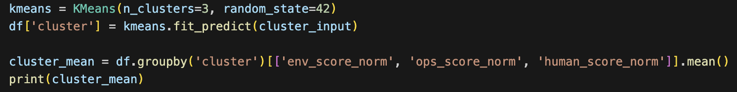
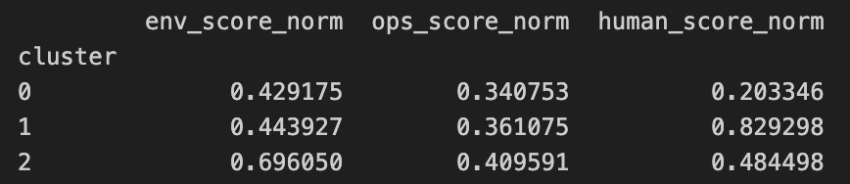
Data Analysis - Clustering
Clustering
KMeans
: KMeans clustering based on normalized factor scores (n=3)
: Store which cluster each data belongs to in df['cluster']
: Calculate average score for each cluster
→ Use to identify cluster characteristics

Slide 13
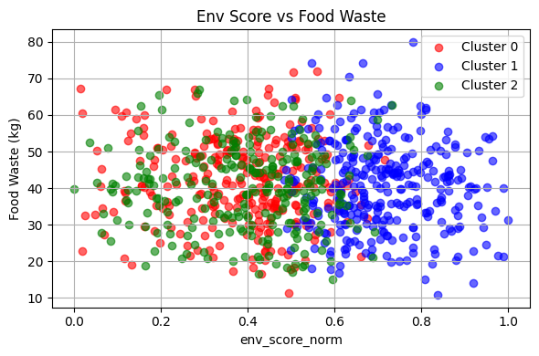
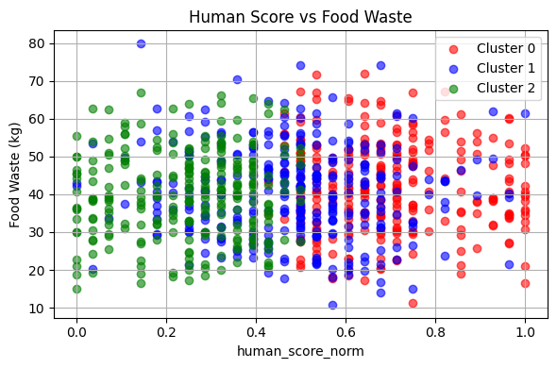
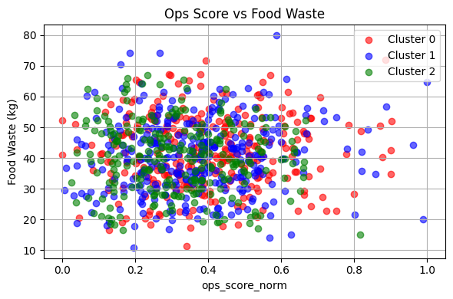
Data Analysis -Clustering
Cluster Visualization
Cluster
1. Cluster 0 : Consists of clusters with high human_score
2. Cluster 1 : Configure clusters with high env_score
3. Cluster 2 : All factors are evenly distributed and all three scores are low

Slide 14
Data Analysis – K-Means Clustering + Linear Regression
Why? used Linear Regression - Effectiveness
1. Interpretability of the Model
Coefficients allow us to quantify how much and in what direction each variable affects the target (food waste).
2. Cluster-Specific Variable Influence
Enables clear comparison of impact factors across clusters, helping to identify key drivers like human, environmental, or operational factors in each group.
3.Low Complexity, Fast Execution
Linear regression assumes a simple relationship, making it quick to train and evaluate without complex tuning.
4. Effective with Normalized Data
Works well with data scaled using MinMax or StandardScaler, making coefficient magnitudes more comparable across features.

Slide 15
Data Analysis - Linear Regression Result by Coefficient
Cluster 0: Human-driven group
staff_experience has a strong negative coefficient(-1.8), meaning more experience significantly reduce waste.
Kitchen_staff is positively weighted(+0.08), implying more staff may cause inefficiencies.
Key Factor: Staff experience.
Feature | Cluster 0 | Cluster1 | Cluster2
temperature | 0.04 | 1.25 | 0.56
humidity_percent | 0.09 | 1.73 | -0.05
meals_served | 6.08 | 6.14 | 7.13
special_event | 2.84 | 3.95 | 2.61
day_of_week | -0.35 | 0.42 | 0.41
kitcen_staff | 0.84 | 1.08 | -0.38
staff_experience | -1.88 | -0.99 | -0.40
Cluster 1:Envrionmentally Sensitive Group
Temperature and humidity both have positve influence.
Special_event is most influential.
Key factor: Climate and events.
Cluster 2: All overall Lowest Group
meal_served has the strongest influence(+7.13), meaning food waste is highly correlated.
Negative coefficient for kitchen_staff(-0.38) indicates more staff slightly reduces waste.
Key factor: meal quantity
*Since special_event is a binary feature can result in a relatively large regression coefficient.

Slide 16
Data analysis - Linear Regression Conclusion
Cluster 0
When the experience level of kitchen staff is low, food waste increases significantly, especially during special events.
Cluster 1
This cluster is highly sensitive to environmental factors such as temperature and humidity, and is still significantly affected by special events.
Cluster 2
The amount of meals served is the most critical driver of food waste, while the impact of staff size or experience is relatively minor.

Slide 17
Data Analysis - K-Means Clustering + LGBM Regressor
Use Clustering & Regression
Why?
How?
Q. Why did you use clustering and regression together?
Q. How did you use K-Means and LGBM Regressor?
Data heterogeneity handling, local prediction model creation, accuracy improvement, ease of interpretation, etc...
K-means: use MinMaxScaler to normalize all features to [0, 1].
LGBMRegressor : Divide the data into clusters, then split the training/validation data for each cluster using train_test_split().

Slide 18
Data Analysis
Comparison with another answers-1
item | Ours | Answer
Apply clustering | Create clusters with KMeans (n_clusters=3) | No clustering
Leveraging clusters | Split data by cluster ID and apply a separate regression model to each cluster | Treat your entire data as one model
Benefits | Learn complex patterns with cluster-specific models | Simple structure with full integration processing without splitting data
Cons | The number of clusters (n=3) needs to be specified in advance, and improper division can actually degrade performance | Possible performance degradation when data is heterogeneous
Compare
clustering aspects

Slide 19
Data Analysis
Comparison with another answers-2
item | Ours | Answer
Model Type | LGBMRegressor (based on LightGBM) | GradientBoostingRegressor (based on sklearn)
Number of models | As many individual models as there are clusters (3) | Single model
How you learn | Train_test_split per cluster and then train separately | Pipeline training on full data
Hyperparameters | n_estimators=1000, learning_rate=0.01, etc. (conservative learning) | n_estimators=100, learning_rate=0.15 (aggressive learning)
Compare
Regression aspects

Slide 20
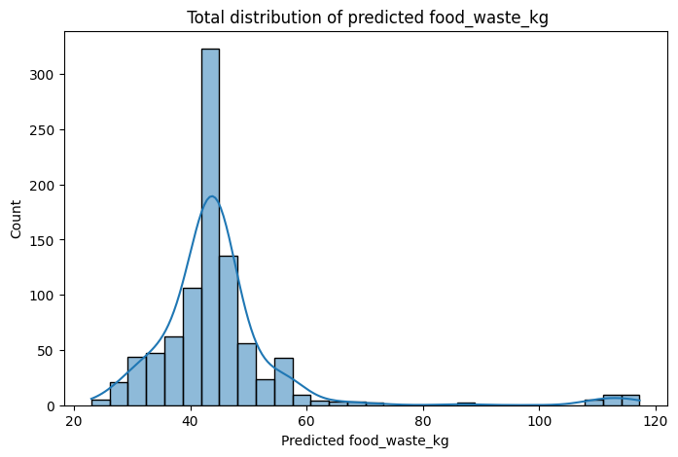
Data Analysis
Graph Analytics
What the graph tells us about each cluster
Cluster 0 or 1 (more likely to be the center cluster) : Predicted values concentrated in the 40-50 kg range → representative of the central tendency of the overall data
Cluster 2 (↑ likelihood of being a high-prediction group) : Rare but present large predictions in the 80-120 kg range

Slide 21
Evaluation
LGBMRegressor vs LinearRegression
Separation | LGBMRegressor | Linear Regression
Pros | Can learn non-linear relationships - Automatically reflects interactions between features based on trees - Supports automatic handling of missing values - Easy to analyze feature importance - Easy to control overfitting (early_stopping, max_depth, etc.) - Good for customized learning by clusters | Simple and fast to implement - Intuitive to interpret (utilizing regression coefficients) - Low risk of overfitting (especially on small datasets) - Can be utilized as a classic baseline model
Cons | Structure is complex and requires tuning - Learning can be slow - Interpretation is not intuitive (non-linear decision boundaries) - Per-cluster models increase administrative complexity | Cannot learn non-linear relationships - Cannot reflect interactions between traits - Very sensitive to handling missing values, outliers, and categorical variables - Has performance limitations with complex data

Slide 22
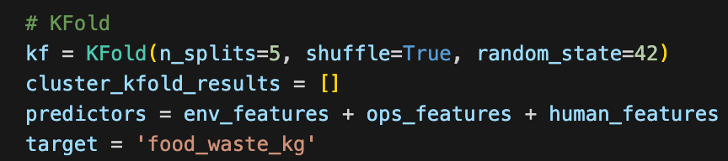
Evaluation - K-Fold (Linear Regression)
Pipeline
1. Unsupervised Clustering
2. Supervised Learning per Cluster
3. Evaluation: K-Fold Cross -Validation
1.Data Splitting After Sturcture
KMeans(n_cluster=3) was used to split the data into 3 Cluster(0,1,2)
2.Applying K-Fold within Each Cluster
For each Cluster:
split the data into features X and target y
Apply K-Fold(n_split = 5) to divide the data into 5 Folds
-> Each cluster undergoes 5 rounds of training and validation
3.Iterative Training & Evaluation per Fold
In each iteration:
Use X_train, y_train to train a LinearRegression model
Predict on X_test, evaluate using y_test
Evaluation metrics:
MSE (Mean Squared Error)
R² (R-squared)

Slide 23
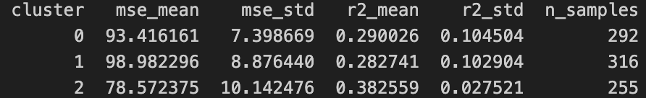
Evaluation - K-Fold (Linear Regression)
Cluster 0 - Human-Focused Cluster
MSE: 93.4 / R²: 0.2900
Influenced by human operational factors.
Although staff_experience is an ordinal variable (0, 1, 2), which can limit expressiveness in linear models, its categorical nature supports clear, rule-based policy design.
Cluster 1 - Envionment-Sensitive Cluster
MSE: 98.9 / R²: 0.2827 (Lowest performance)
Environmental factors often behave non-linearly and with high variability, making them harder to model accurately using linear regression.
While special_event appears influential, its binary nature may exaggerate importance due to normalization, and interactions with environmental variables might be overlooked.

Slide 24
Evaluation - K-Fold
Cluster 2 - All overall Lowest Group
MSE: 78.6 / R²: 0.3826 (best performance)
Waste generation in this group is highly correlated with meal volume, forming a near-linear and predictable relationship.
The strong signal-to-noise ratio and structural simplicity of this cluster enable more accurate predictions even with basic models.
Why the R² Scores & MSE were unstable..?
The relatively unstable R² & MSE values are not due to flaws in the model itself, but rather stem from limitations in the data characteristics and feature design.
Several key input features are discrete or binary, which makes it difficult to accurately capture the variance in the continuous target variable food_waste_kg.
The model also does not account for feature interactions. In real-world restaurant operations, factors like temperature + event occurrence or staff count + meal volume interact and jointly impact food waste.
However, the linear model treats these variables independently, which limits explanatory power.

Slide 25
Future Directions & Model Enhancement Strategy...
1. *Introduce Non-Linear Models (Random Forest, XGBoost, Neural Net...)
Implementing models like Random Forest, XGBoost, or Neural Networks can capture complex relationships better and improve R² performance
2. Feature Engineering with Interaction Terms
(ex. kitchen_staff × special_event OR temperature × humidity)
Currently we only considered each variable individually but we can create combinatorial variables to reflect potential relationships.

Slide 26
Team Roles & Lessons Learned
박유원 202135768 Data Research Visualization PPT | 이동호 202239878 Evaluation Regression PPT | 채민석 202334166 Data Analysis Regression PPT | 이나영 202434800 Data Preparation Clustering PPT
이번 과제를 통해 데이터분석이 어떤 과정으로 이루어지는지뿐만 아니라 데이터분석의 필요성과 유용성, 그리고 소요되는 자원과 시간을 몸소 경험할 수 있었고 조원들과 함께 협력하여 문제를 해결하는 기회를 가져 전반적으로 지식과 학습법을 익힐 수 있는 유익한 시간을 보낼 수 있었습니다. 감사합니다. | 데이터 전처리부터 해석까지 전체 end to end process를 조원들과 함께 경험하며, 데이터가 제공하는 구조적 통찰과 다양한 아이디어의 중요성을 절실히 느꼈습니다. 수업 시간에 배운 여러 내용들을 본 프로젝트에 최대한 녹여내려 노력하며 역량 강화에 도움이 되었습니다. 또한 주어진 결과를 다양한 관점으로 해석하는 법을 새롭게 배운 것 같아 많이 깨우쳤습니다. 감사합니다. | 전처리된 dataset을 기반으로 전체적인 모델을 설계하는 역할을 맡았으며, 주어진 dataset에 수업시간에 언급되었던 K-means, LGBMRegressor를 직접 사용해 보다 실무적인 경험을 할 수 있었습니다. 데이터 전처리와 군집별 모델 설계가 예측 정확도에 얼마나 큰 영향을 미치는지도 배울 수 있던 활동이었습니다. 감사합니다. | 데이터 전처리 과정이 분석 단계와 함께 반복적으로 수정되며 진행되는 과정임을 체감했습니다. 또한 조원들과 다양한 관점에서 데이터를 논의하며 데이터를 획일적으로 바라보는 대신 다양한 패턴과 특성을 발견하고 이에 맞춰 분석하는 접근 방식이 깊이 있는 통찰을 도출하는 데 기여함을 새롭게 배울 수 있는 의미 있는 경험이었습니다. 감사합니다.

Slide 27
Thank you
The entire process and outcomes of our project are openly shared at
https://github.com/dongramiho/Datascience_termproject

Slide 28
Appendix
Planned(In proposal) vs Actual Approach
Initial Proposal
Perform clustering by individual factors (Environment, Operations, Human)
Conduct regression analysis within each cluster
→ Goal: Understand how each factor independently influences food waste
Challenges Encountered❗️
1.Limited Dataset Size
Total samples: 911
After preprocessing: ~870 usable entries
3 clusters per factor × 3 factors = 9 clusters
→ Fewer than 100 samples per cluster → Unstable training & reduced reliability
2.Lack of Factor Interaction Control
Clustering based on a single factor makes it difficult to control for variation in other factors
Example: Clusters based on environmental conditions still include mixed operational and human characteristics
Final Implemented Approach🌟
Performed clustering using combined features: Environment + Operations + Human
Recognized that in real-world restaurant settings, these factors are interdependent, not isolated
Grouped data based on similar overall operational conditions
Then, conducted regression analysis within each cluster to identify key influencing variable.

